Slide 1














Student Loan Debt and Average Starting Salary After 4 Year University Completion
JAMS ETL PROJECT

Slide 2

Extract, Transform, Load
Extract
We extracted data from 2 csv files: 1 on student loan debt and1 on average salary from highest ranked schools
Transform
We cleaned the csv files using pandas and python
Load
We loaded the final data frames to SQL using sqlalchemy engine and filtered the data

Slide 3
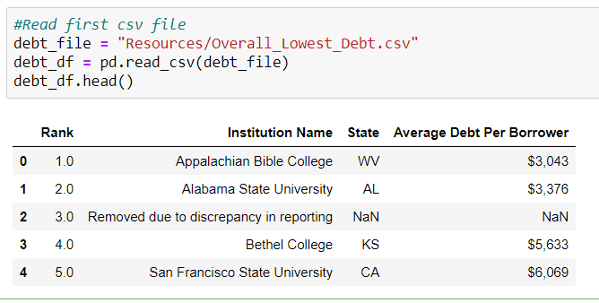
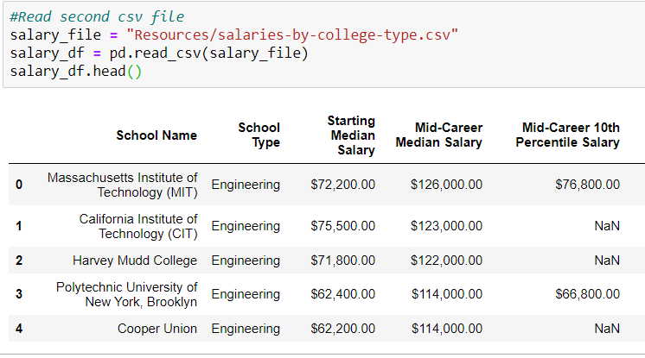
Step 1: Create Dataframes from Two CSV Files
CSV File 1
CSV File 2

Slide 4
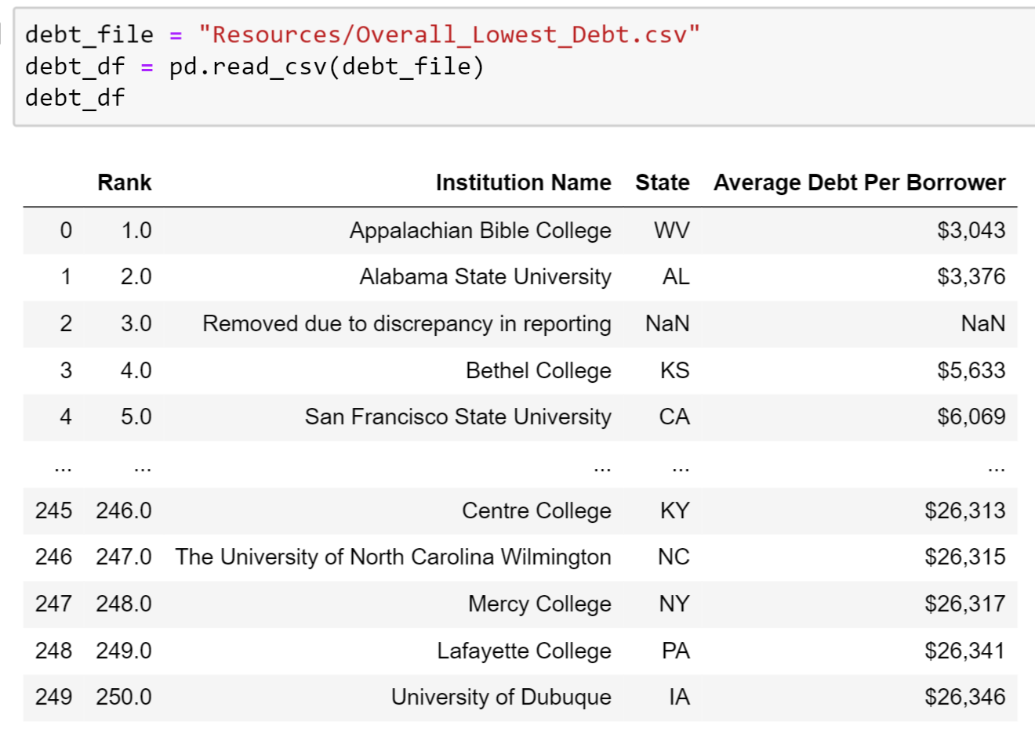
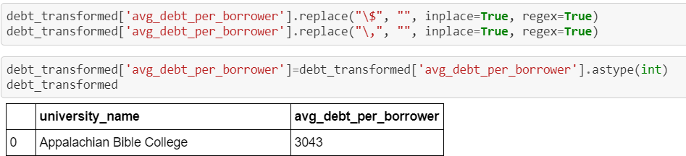
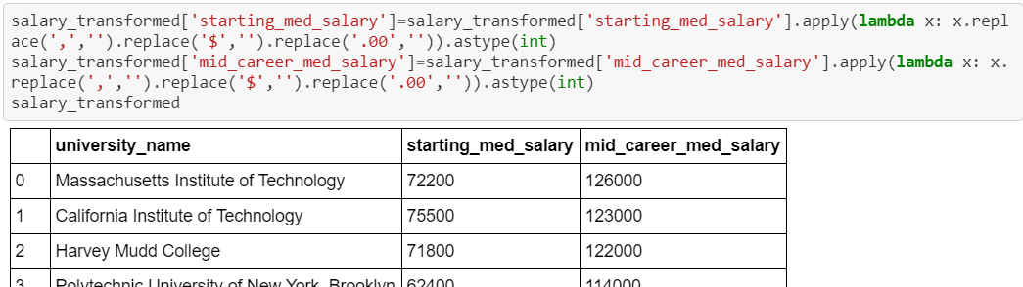
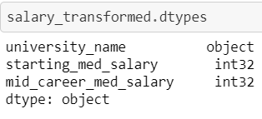
Step 2: Transform the Data and Join
Data Cleaning
We dropped NaN rows and columns we didn’t need for our analysis and made a copy of the dataframe.
We converted object data types to integers
We also made the university names match in both dataframes so that we could merge on the name.
Aggregating

Slide 5
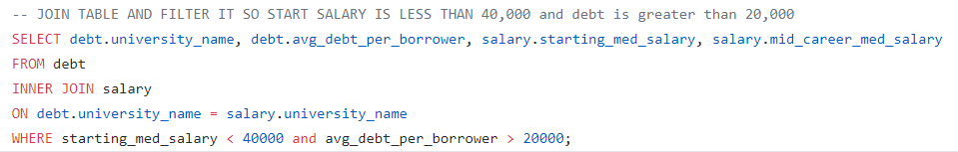
Step 3: Transform the Data and Join
Data Cleaning
Filtering
We filtered so that salary is less than $40,000 and debt is greater than $20,000 in SQL
Aggregating
We tried aggregating another salary dataset but a manual check showed that the universities listed did not match any of the universities listed on our debt dataset. The data was pre-aggregated for us in the datasets that we used.

Slide 6
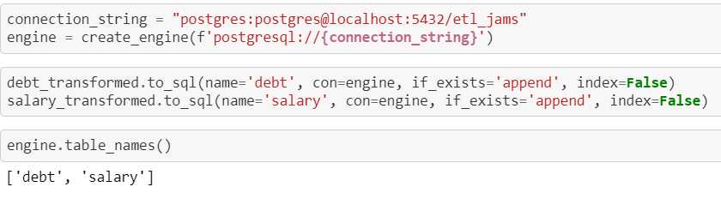
Step 4: Load the Data into SQL Database
Joining
We loaded the data into SQL using sqlalchemy engine and used the university name to join the two datasets and create a new table showing average debt versus average salary
Using SQL queries we were able to create new views to combine data from the two tables.
Creating SQL queries

Slide 7
Analysis: We joined the two data sets on the university name to compare student loan debt versus the average salary after graduation.

